Slide 1



Cover Page
Monday, 17 Nov 2025
PROJ703/ PROJ903 International Challenge Project “Eurobot”
By
ROBO-UN

Slide 2
SUMMARY
Progress Report -03
Simulation –04-05
Programming -06
Design -07
Conclusion -08
Page - 02

Slide 3
PROGRESS REPORT
What we have done:
Simulation:
(Navigation): SLAM & Nav2 integration
(Physics): URDF with Mecanum drive plugin
(Perception): Crate detection & pose estimation
(Docs): Perception & Navigation packages documented
Design: Refining the Design.
Documentation: Structure + templates
Page - 03

Slide 4
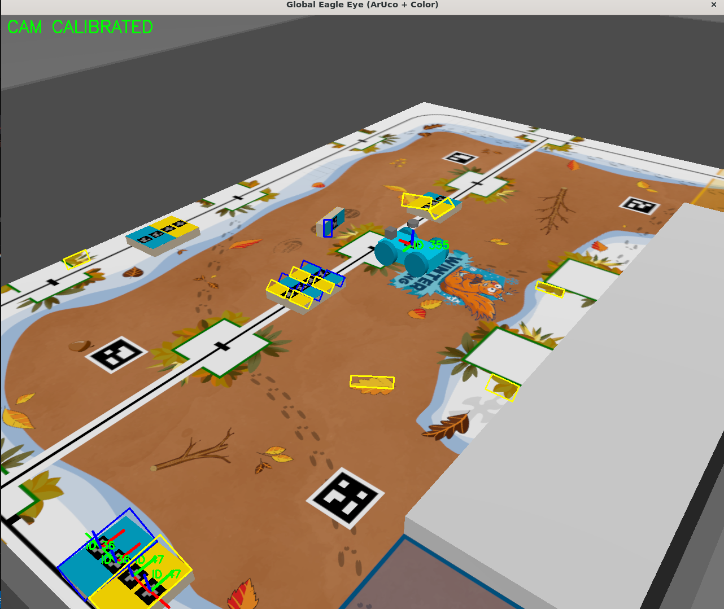
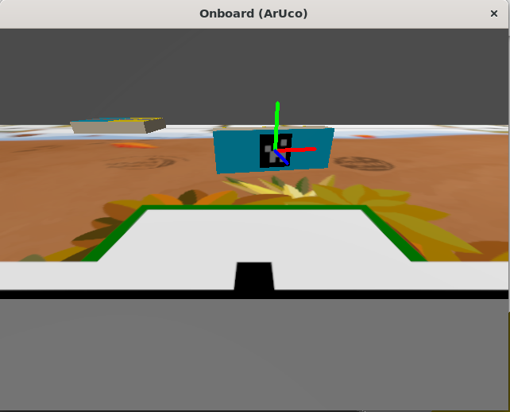
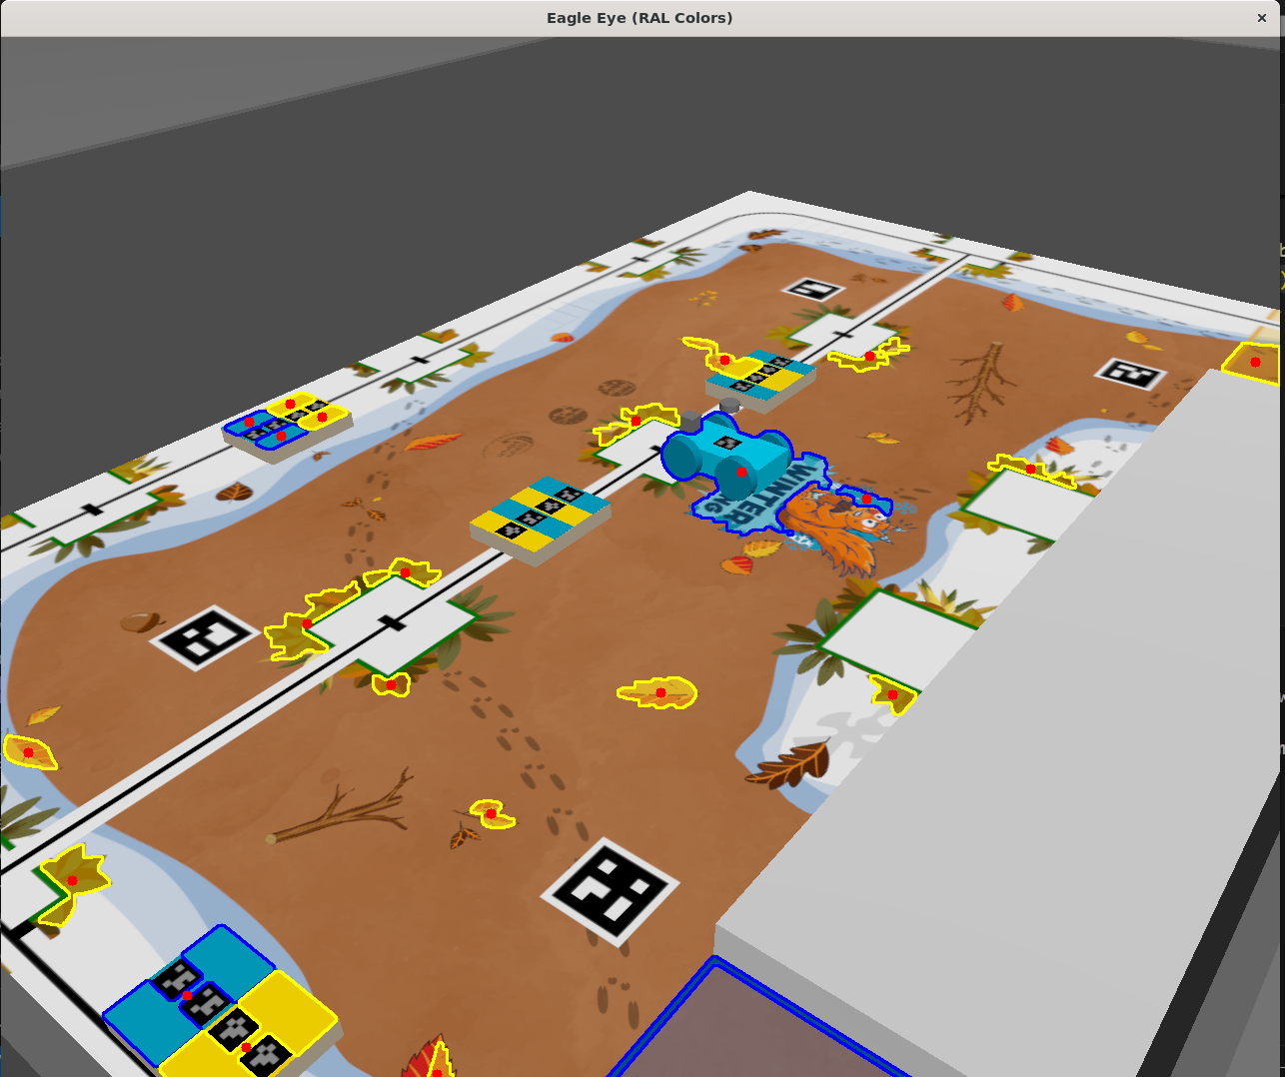
SIMULATION: Crate identification and localization
Page - 04

Slide 5
SIMULATION: Navigation stack's configuration
SLAM Toolbox Configuration (Mapping)
Mode: Configured in asynchronous online mode (Karto).
Grid Resolution: 0.05 m
Update Rate: 5.0 s
Sensor Range: 20.0 m
Localization: AMCL
Nav2 Stack Tuning (Planning & Control)
Global Costmap: Static Layer and Inflation Layer
Local Costmap: 3x3 rolling window
Controller: DWBLocalPlanner
Page - 05

Slide 6
DOCUMENTATION
5 Axes:
Management & Strategy
Design & Engineering
Simulation & Programming
Testing & Iteration
Appendix & Technical Data
Page - 05

Slide 7
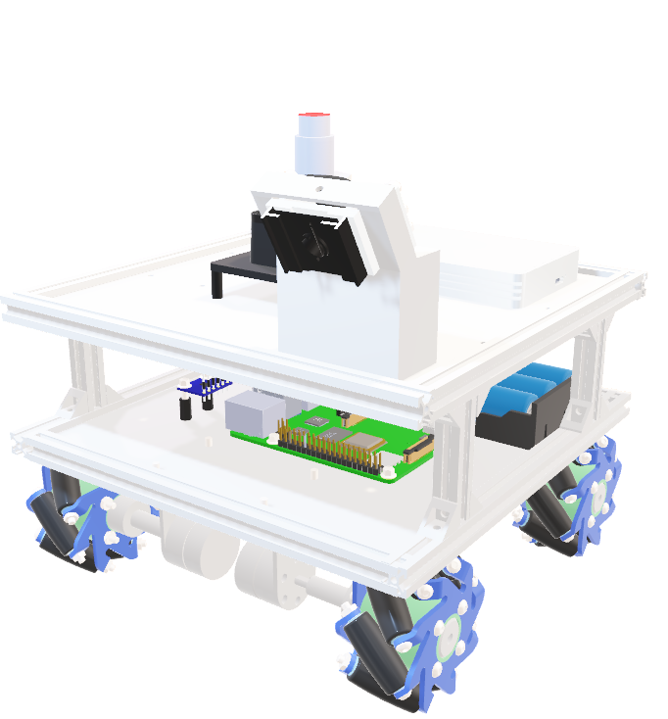
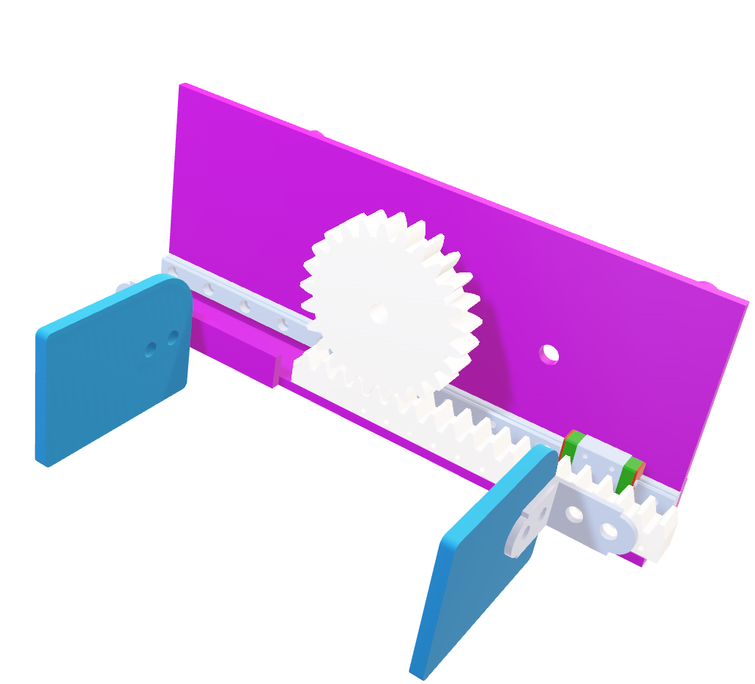
CAD Modelling
Page - 06

Slide 8
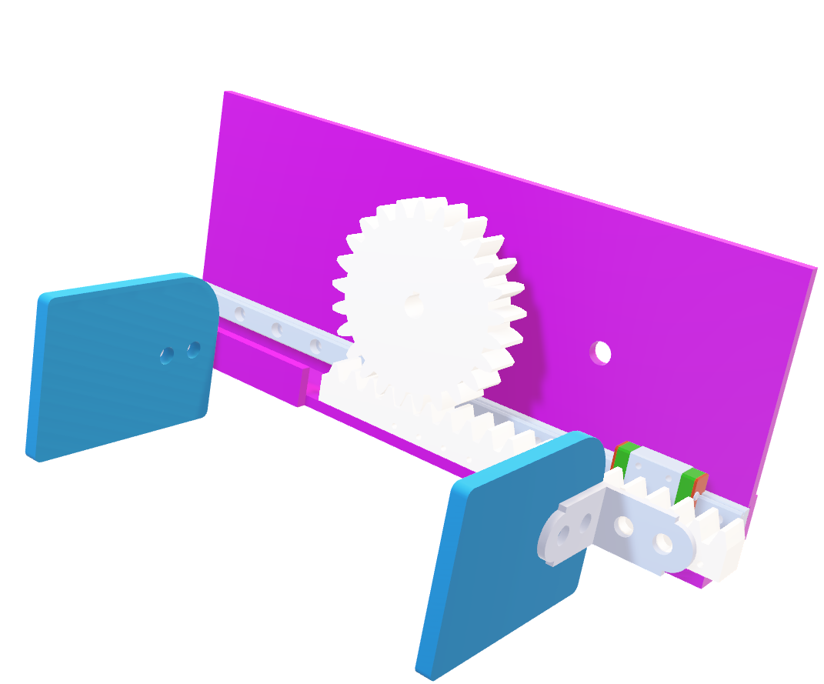
CAD Modelling
Gripper Modification:
Adding Liner Guide
Make stronger Joints
Up next:
Calculating mechanics
Perform Simulation
Documentation
Page - 07

Slide 9
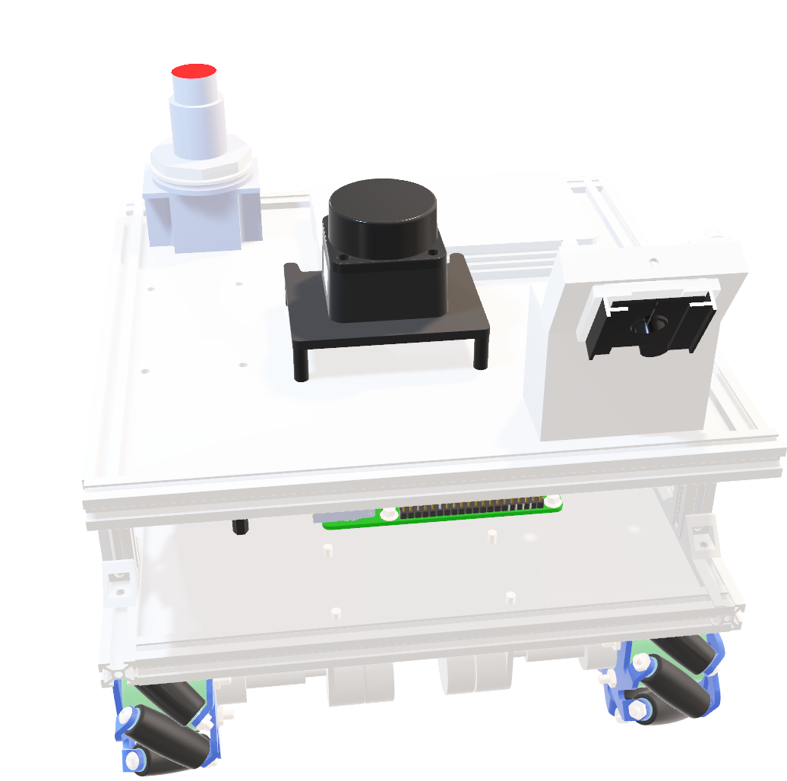
CAD Modelling
Robot Body Modification:
Adding components ：LidarSD card Emergency button， and power button.
Support for components
Page - 07

Slide 10
CONCLUSION
What we must do for project closure:
Simulation: Test the navigation stack + Develop the task planner
Design: Calculating mechanics, Perform Simulation.
Documentation: More Templates + Finish writing
Page - 8

